Slide 1

Stronger After the Fall:
Compensatory Fricativization of /b d g/ after Coda /s/ Weakening
Santiago Arróniz
University of Nevada, Reno
LSRL 2025 - PUCMM

Slide 2
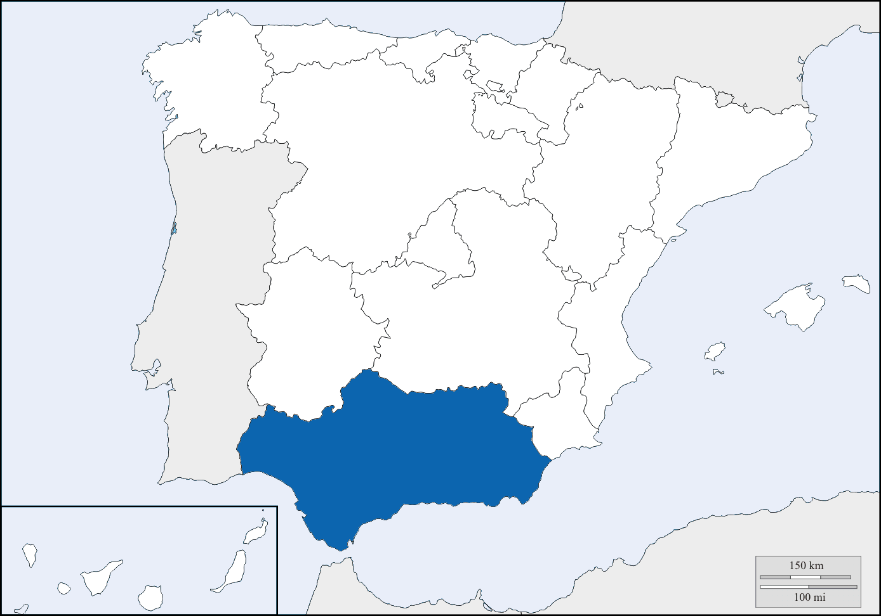
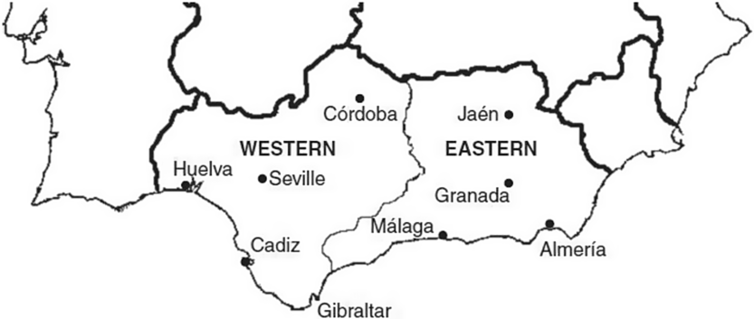
Why Western Andalusian Spanish?
WAS as a “testing ground” for lenition & compensation
Two hallmark processes:
  /s/ weakening (aspiration, elision, etc.)
  spirantization of /b d g/ (approximants vs. fricatives)
LSRL 2025 - PUCMM
1

Slide 3
The Lenition of /s/ in Spanish
The reduction of /s/ in coda position has been widely reported to occur in many different varieties of Spanish
Depending on the dialect, this lenition process has been described to result in:
  an aspirated variant (Bybee, 2000; Hualde, 2005; Lipski, 1994)
  a voiced variant (Willis et al., 2015)
  a glottal occlusion (Luna, 2010; Valentín-Márquez, 2006; Núñez-Méndez, 2022)
LSRL 2025 - PUCMM
2

Slide 4
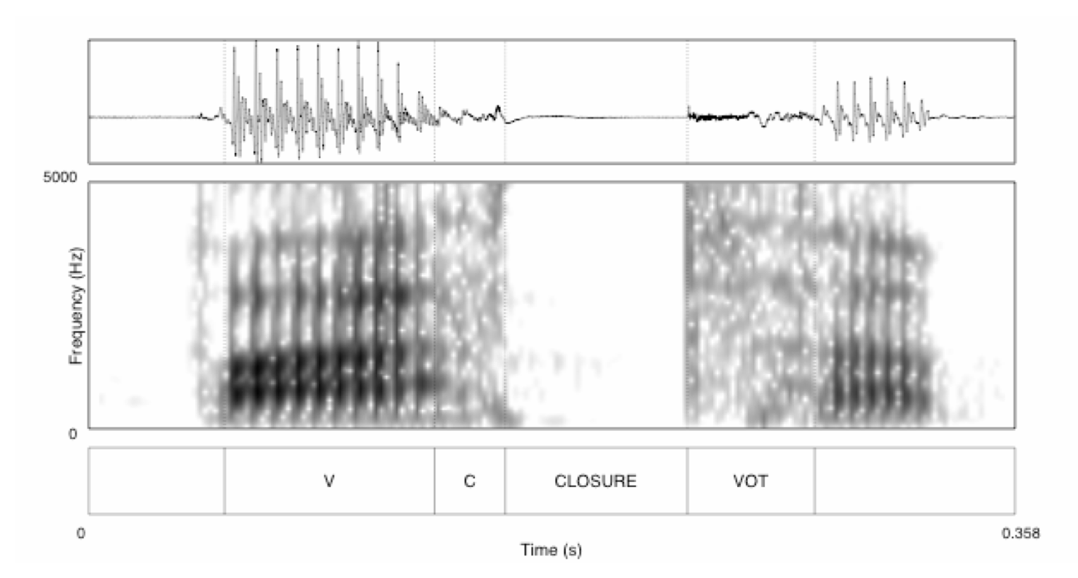
The Lenition of /s/ & Phonological Processes
Previous work on /s/ + /p t k/ clusters found an increased VOT on the voiceless stop in WAS (Torreira, 2006, 2007; Ruch and Harrington, 2014; Ruch and Peters, 2016; Martínez Celdrán and Fernández Planas, 2007; del Saz, 2015; Gilbert, 2022; inter alia)
Post-aspiration, as well as affrication of /s/ + /p t k/ clusters have also been documented in WAS (Del Saz, 2023; Moya Corral, 2007; Ruch, 2010, 2012, 2013; Villena Ponsoda et al., 2016)
In EAS, there is a lengthening and lowering of the preceding vowel (Hualde and Sanders, 1995; Henriksen, 2017)
An occlusive variant of /b d g/ is also found in Puerto Rican Spanish when followed by an elided /s/ (Galarza et al., 2014)
LSRL 2025 - PUCMM
3

Slide 5
The Spirantization of /b d g/ in Spanish
Distribution of voiced stops and approximants
(Navarro Tomás, 1918/1977; Martínez Celdrán 1984, 2022)
/b/
[b] after a pause, nasal [bom.ba]
[β̞] in every other place [la.β̞a. β̞a]
/d/
[d] after a pause, nasal, lateral [fal.da]
[ð̞] in every other place [la.ð̞o]
/g/
[g] after a pause, nasal [poŋ.go]
[ɣ̞] in every other place [la.ɣ̞o]
Approximant ≠ Fricative
LSRL 2025 - PUCMM
4

Slide 6

The Phenomenon
Compensatory Voiced Fricatives (CVFs)
Traditional mentions (Romero 1995, Alvar 1996) but not acoustically analyzed
Hypothesis: loss of /s/ triggers strengthening in /b d g/
/b/
/d/
/g/
Approximant | [ β̞ ð̞ ɣ̞ ] | una bota | una dama | una gata
Fricative | [ v ð ɣ ] | una(s) bota(s) | una(s) dama(s) | una(s) gata(s)
Overt | [sβ̞ sð̞ sɣ̞] | unas botas | unas damas | unas gatas
LSRL 2025 - PUCMM
5

Slide 7
The Phenomenon
Compensatory Voiced Fricatives (CVFs)
Traditional mentions (Romero 1995, Alvar 1996) but not acoustically analyzed
Hypothesis: loss of /s/ triggers strengthening in /b d g/
/b/ → [ β̞ ] = [ v ]
  /s/ → Ø + /d/ → [ ð̞ ] = [ ð ]
  /g/ → [ ɣ̞ ] = [ ɣ ]
LSRL 2025 - PUCMM
6

Slide 8
Research Questions
RQ1. Does coda /s/ lenition trigger fricativization of /b d g/?
RQ2. What acoustic cues define CVFs?
RQ3. Are CVFs systematic, or gradient variation?
LSRL 2025 - PUCMM
7

Slide 9
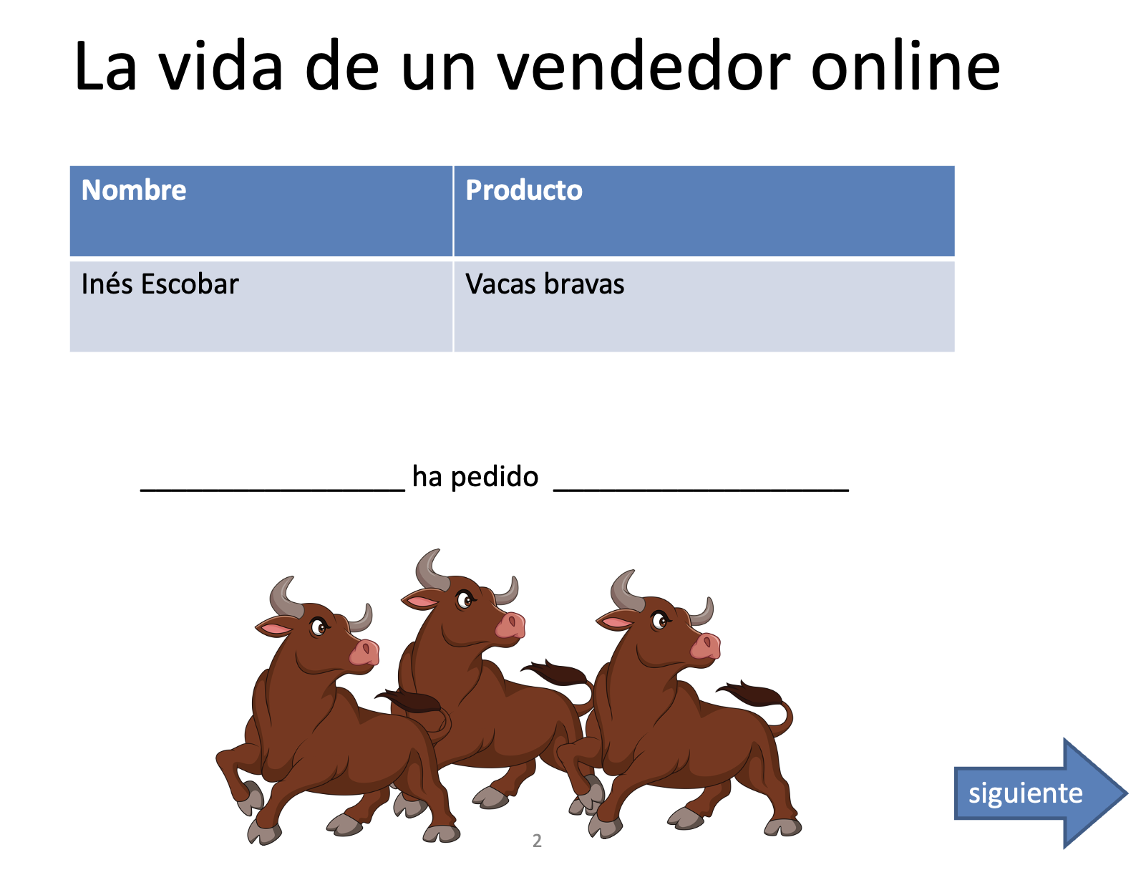
Data & Methods
Semi-Guided Picture Description Task:
152 target tokens designed to elicit singular/plural forms
  Proper Name + ha pedido + una/unas + /b- d- g-/
36 speakers from Seville (WAS)
    18 to 60 years (M = 21.77)
Acoustic analysis with Praat
LSRL 2025 - PUCMM
8

Slide 10
Acoustic Features
Duration: How long the sound lasts
Spectral Centroid: How bright or sharp a sound is
Spectral Spread: How wide the frequencies of a sound are
Zero Crossings: How fast the sound wave vibrates
Mean HNR (Harmonics-to-Noise Ratio): How clear or noisy the sound is
Mean Intensity Ratio: How loud the sound is compared to other
Why Multiple Features?
  Each feature tells a different part of the sound’s story
  Expect to get a full picture of what makes one sound different from another
LSRL 2025 - PUCMM
9

Slide 11
Acoustic Features
Duration: How long the sound lasts
Spectral Centroid: How bright or sharp a sound is
Spectral Spread: How wide the frequencies of a sound are
Zero Crossings: How fast the sound wave vibrates
Mean HNR (Harmonics-to-Noise Ratio): How clear or noisy the sound is
Mean Intensity Ratio: How loud the sound is compared to other
Why Multiple Features?
  Each feature tells a different part of the sound’s story
  Expect to get a full picture of what makes one sound different from another
LSRL 2025 - PUCMM
10

Slide 12
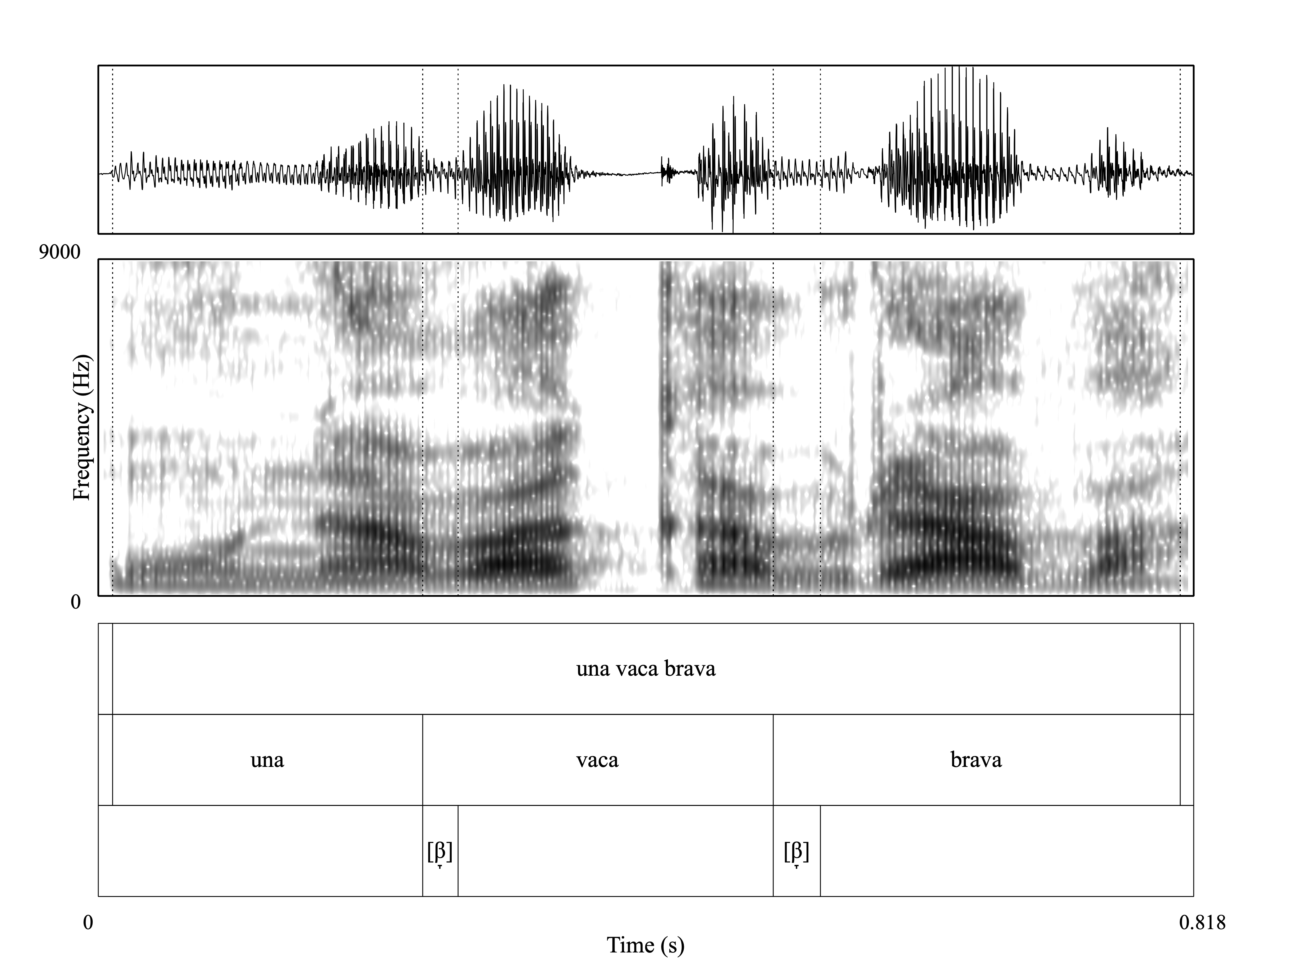
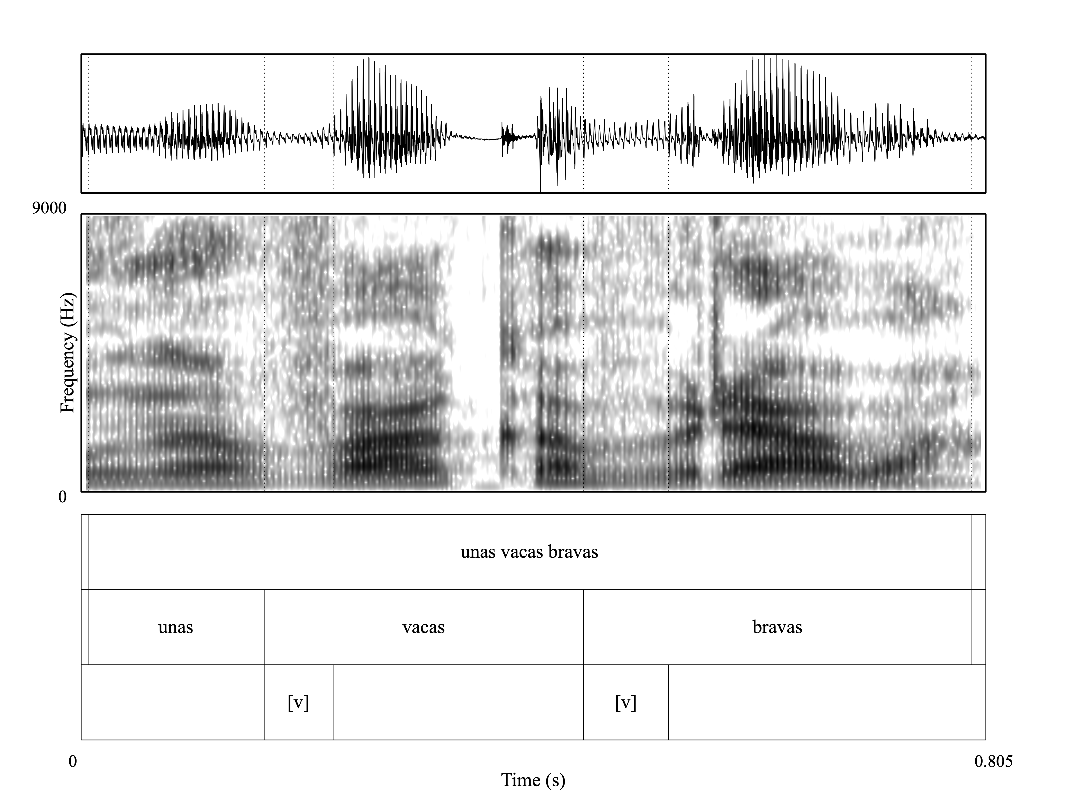
Example
26ms
35ms
62ms
76ms
Approximant Realizations
Fricative Realizations
LSRL 2025 - PUCMM
11

Slide 13
Contextual Expectations
The production task was designed to trigger a particular phonological process:
Singular → Intervocalic /b d g/ (una bota) → approximant [ β̞ ð̞ ɣ̞ ]
Plural → Syllable final /-s/ + /b d g/ (unas botas) → no /s/ + fricative [ v ð ɣ ]
LSRL 2025 - PUCMM
12

Slide 14
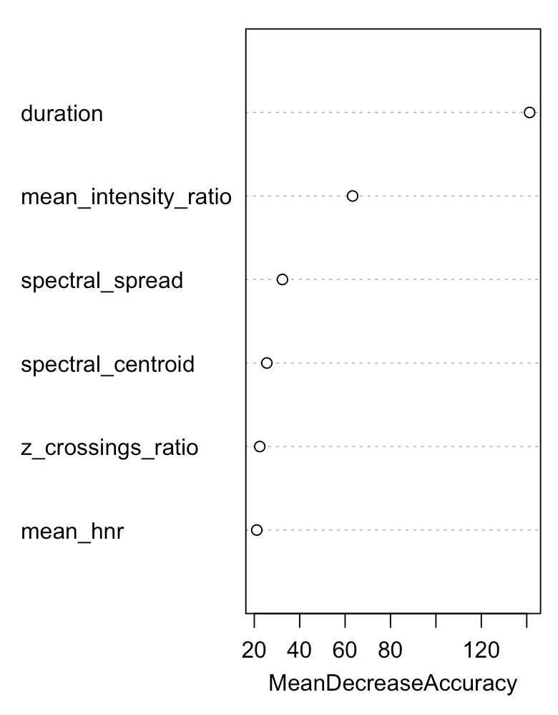
Results
Which Acoustic Features Matter Most?
Multivariate Modeling: Random Forest
Importance of different acoustic features in predicting sound classification
  Duration is the most important predictor
  Mean Intensity Ratio and Spectral Features also play significant roles
  Zero-Crossings Ratio and Mean HNR contribute less
LSRL 2025 - PUCMM
13

Slide 15
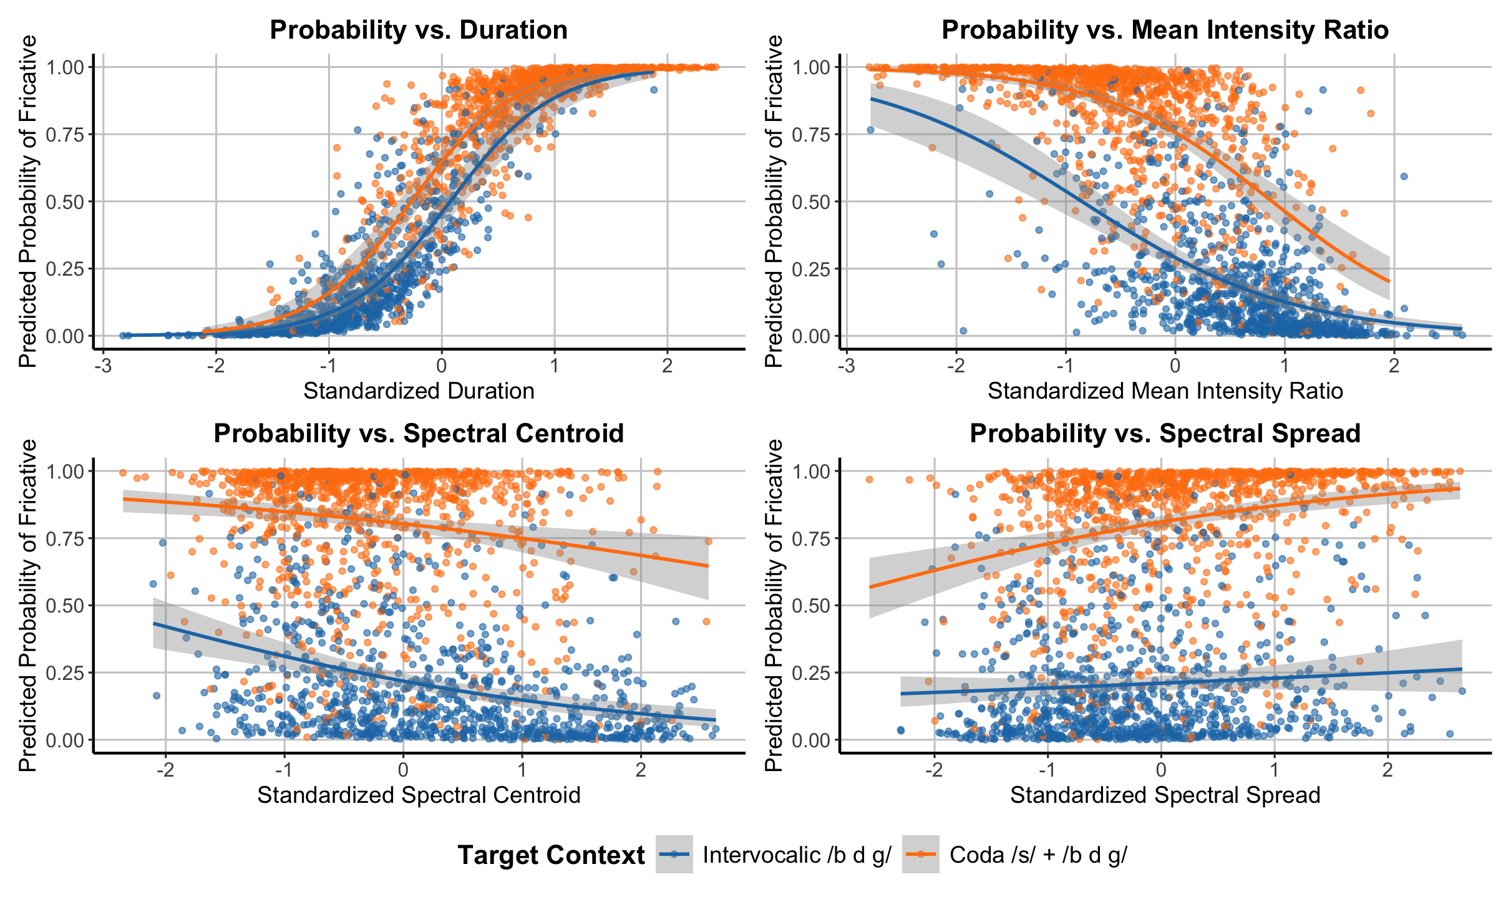
Results
GLMM
Predictor | Estimate | Std. Error | p-value
Duration | 2.96 | 0.26 | < 0.001
Mean Intensity Ratio | -0.99 | 0.14 | < 0.001
Spectral Spread | -0.41 | 0.12 | < 0.001
Spectral Centroid | 0.46 | 0.14 | 0.0025
Zero-Crossing Rate | 0.10 | 0.14 | 0.47
Mean HNR | -0.11 | 0.11 | 0.32
LSRL 2025 - PUCMM
14

Slide 16
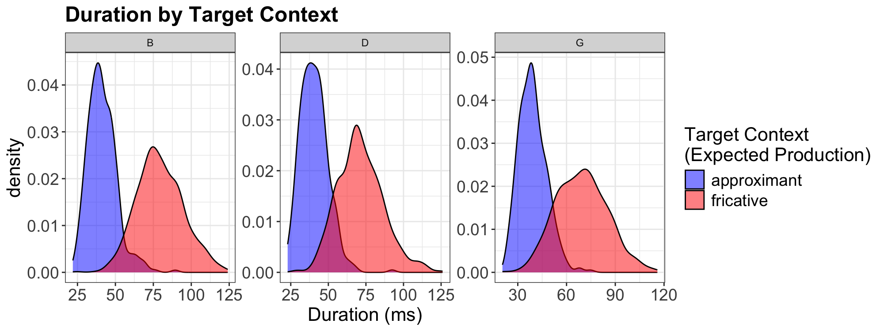
Results
Acoustic Features - Duration
LSRL 2025 - PUCMM
15

Slide 17
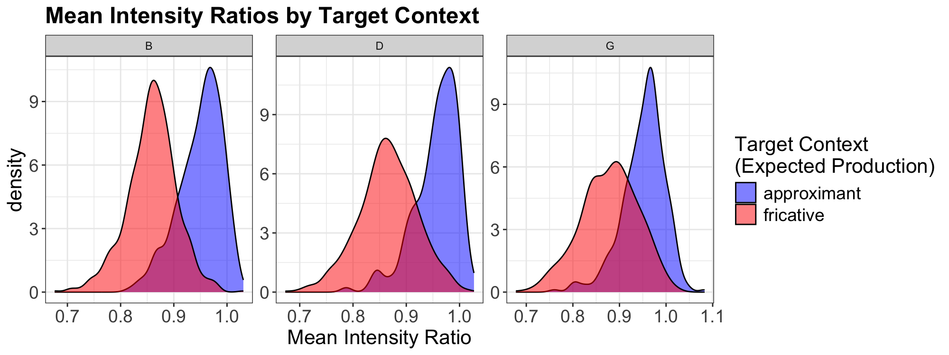
Results
Acoustic Features - Intensity
LSRL 2025 - PUCMM
16

Slide 18
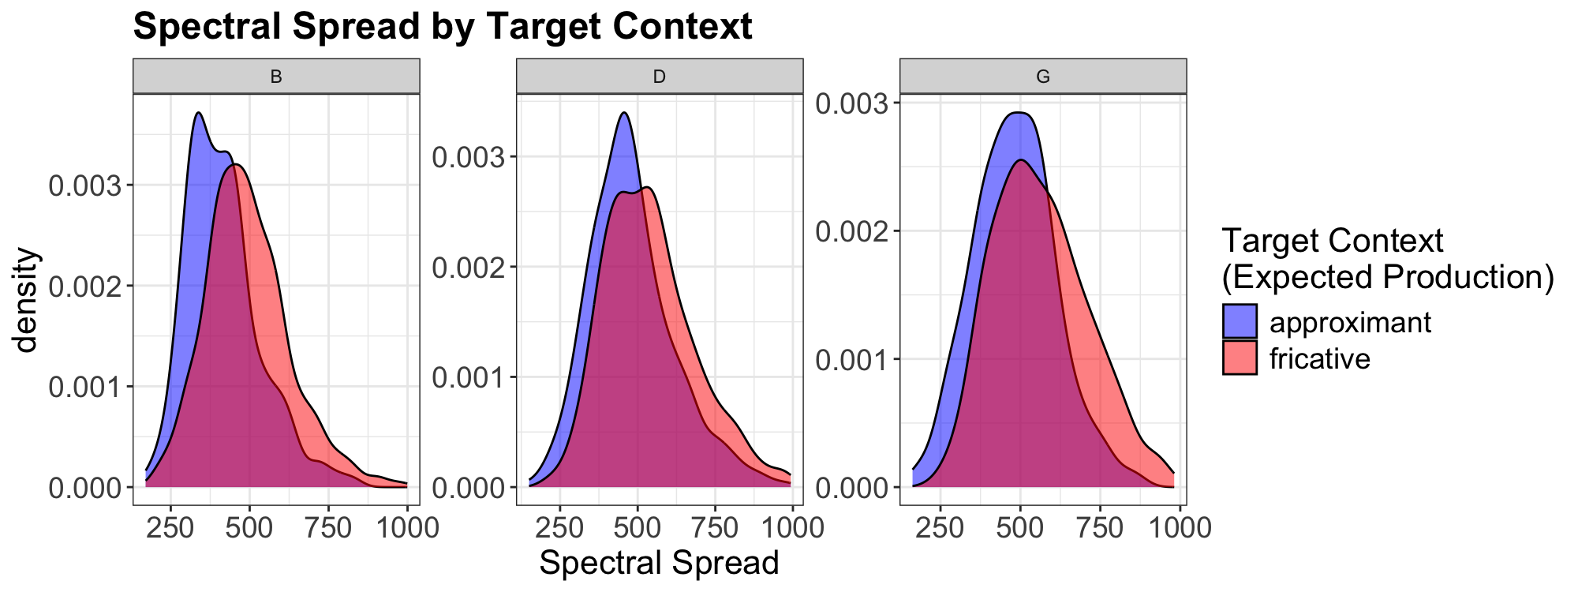
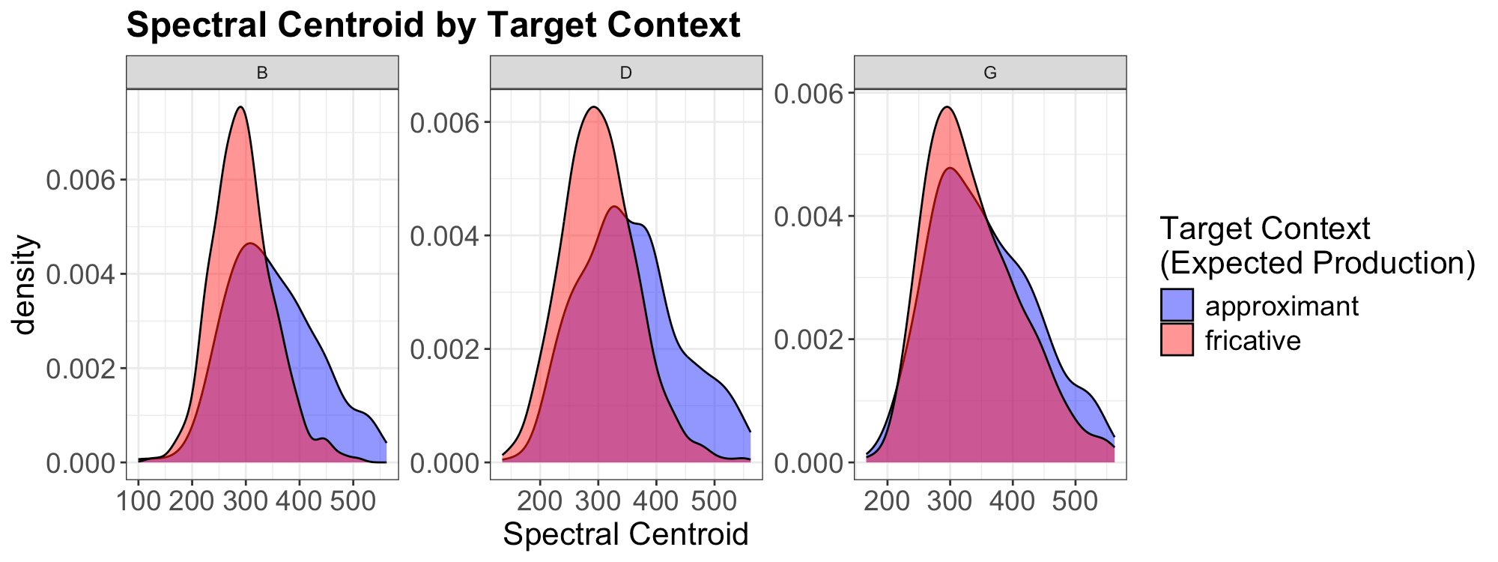
Results
Acoustic Features – Spectral Features
17

Slide 19
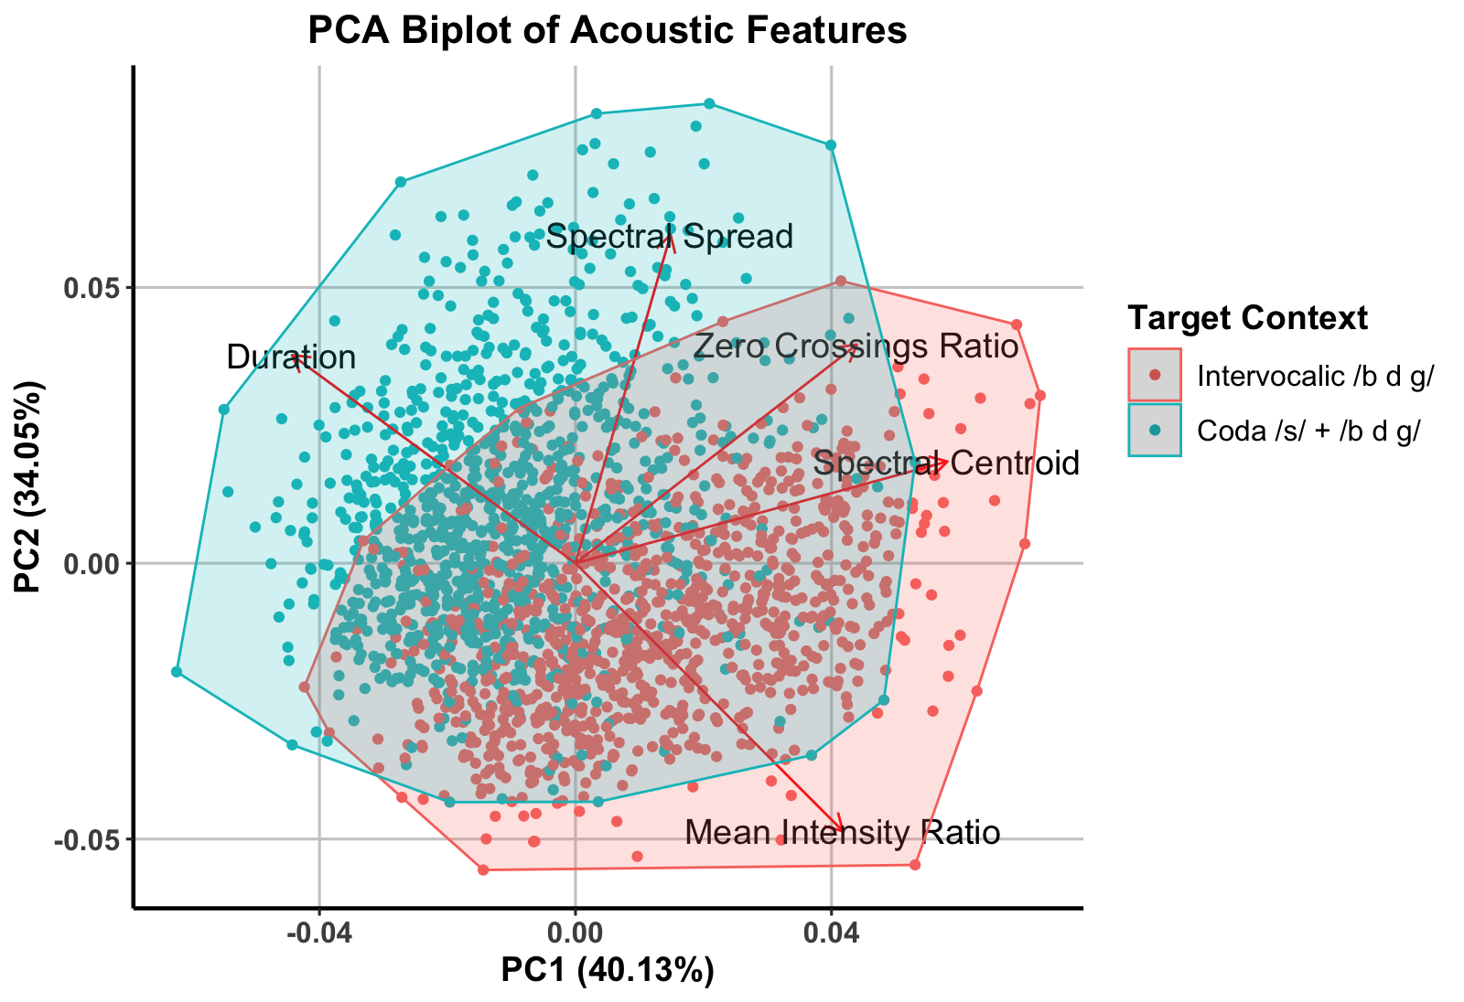
Results
PCA
LSRL 2025 - PUCMM
18
Notes:
Post-/s/ tokens (blue) cluster in the direction of Duration and Spectral Spread, showing systematically longer segments and greater turbulence.
Intervocalic tokens (red) align more with Intensity Ratio and Spectral Centroid, reflecting smoother, approximant-like realizations.
The overlap between groups highlights a gradient continuum, not categorical separation.

Slide 20
Interpretation
/s/ loss triggers compensatory strengthening → following /b d g/ systematically shift toward more constricted realizations
Not incidental → CVFs show a consistent acoustic pattern (longer duration, increased turbulence)
Gradient continuum → productions span from approximant-like to fricative, reflecting structured variation rather than discrete categories
LSRL 2025 - PUCMM
19

Slide 21
Broader Significance
Phonetics / Phonology
  CVFs show how fine phonetic adjustments (duration, turbulence) can enhance coda salience and stabilize contrast
Cross-dialectal evidence
  Adds to typological cases where loss of cues triggers compensatory strengthening, aligning WAS with other leniting systems
Exemplar-based models
  Demonstrates how structured gradience is not random noise, but a pathway to phonologization
LSRL 2025 - PUCMM
20

Slide 22
Conclusion & Future Work
WAS CVFs emerge as a structured, compensatory response to /s/-loss, not random variation
CVFs are defined by duration + spectral turbulence, separating them from intervocalic approximants
Overlap shows variability, but distribution is structured → supports phonologization in progress
CVFs illustrate how fine-grained phonetic detail feeds into phonological adaptation and category restructuring
LSRL 2025 - PUCMM
21

Slide 23
Selected References
Bybee, J. (2000). Lexicalization of sound change and alternating environments. In M. Broe & J. Pierrehumbert (Eds.), Papers in Laboratory Phonology 5: Acquisition and the lexicon (pp. 250–268). Cambridge University Press.
de Haro, A. H., & Hajek, J. (2022). Eastern Andalusian Spanish. Journal of the International Phonetic Association, 52(2), 135–156
del Saz, M. (2015). Effects of place of articulation on Spanish coda /s/ perception. In A. G. Nebot (Ed.), Perspectivas actuales en el análisis fónico del habla. Tradición y avances en la fonética experimental. Universitat de València.
Fernández, R. J. (1999). El andaluz. Arco Libros.
Galarza, I., Delgado-Díaz, G., & Willis, E. (2014). ¿Nuevamente /s/? Una nueva mirada a la elisión de /s/ implosiva en el español de Puerto Rico. In 7th Workshop on Spanish Sociolinguistics.
Henriksen, N. (2017). Patterns of vowel laxing and harmony in Iberian Spanish: Data from production and perception. Journal of Phonetics, 63, 106–126.
Hualde, J. I. (2005). The sounds of Spanish. Cambridge University Press.
Lipski, J. M. (1984). On the weakening of /s/ in Latin American Spanish. Zeitschrift für Dialektologie und Linguistik, 31, 31–43.
Luna, K. (2010). The Spanish of Ponce, Puerto Rico: A phonetic, phonological, and intonational analysis (Doctoral dissertation). University of California, Los Angeles.
Martínez Celdrán, E. (1991). Sobre la naturaleza fonética de los alófonos de /b, d, g/ en español y sus distintas denominaciones.
Navarro Tomás, T. (1977). Manual de pronunciación española (19th ed.). Consejo Superior de Investigaciones Científicas.
Núñez-Méndez, E. (2022). Variation in Spanish /s/: Overview and new perspectives. Languages, 7, 77.
Poplack, S. (1980). The notion of plural in Puerto Rican Spanish: Competing constraints on (s) deletion. In W. Labov (Ed.), Locating language in time and space (pp. 55–67). Academic Press.
Romero Gallego, J. (1995). Gestural organization in Spanish: An experimental study of spirantization and aspiration (Doctoral dissertation). University of Connecticut.
Ruch, H., & Peters, S. (2016). On the origin of post-aspirated stops: Production and perception of /s/+ voiceless stop sequences in Andalusian Spanish. Laboratory Phonology, 7(1), 1–36.
Torreira, F. (2006). Coarticulation between aspirated-s and voiceless stops in Spanish: An interdialectal comparison. In Selected Proceedings of the 9th Hispanic Linguistics Symposium. Cascadilla Proceedings Project.
Torreira, F. (2007). Pre- and postaspirated stops in Andalusian Spanish. In Segmental and prosodic issues in Romance phonology (pp. 67–82).
Valentín-Márquez, W. (2006). La oclusión glotal y la construcción lingüística de identidades sociales en Puerto Rico. In N. Sagarra & J. Toribio (Eds.), Selected Proceedings of the 9th Hispanic Linguistics Symposium (pp. 326–341). Cascadilla Proceedings Project.
Wills, E. W., Delgado-Díaz, G., & Galarza, I. (2015). Contextualized voicing of the voiceless posterior fricative /x/ in Puerto Rican Spanish. In P. M. Butragueño, E. W. Willis, & E. Herrera Zendejas (Eds.), Laboratory approaches to Romance phonology (pp. 52–69). Cascadilla Proceedings Project.
LSRL 2025 - PUCMM
22

Slide 24

¡Gracias!
sarroniz@unr.edu

